Slide 1
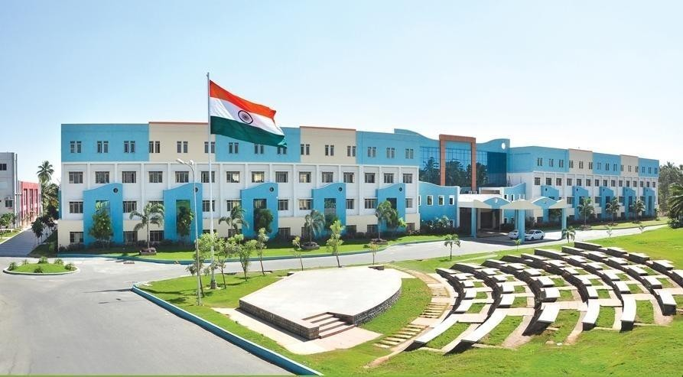

Batch No.: 13
U19EC281 – Mini-Project
Title: AI based Spycamera
Class: II ECE B
Mentor: Mr.M.Vivek Kumar AP/ECE
Team Members Name:
19EC093 – K.SOWNDAR
19EC065 – N.PRAVEEN
19EC079 – S.ROOPAK
19EC091 – G.P.SHWETHAA
Date: 20.04.2021

Slide 2


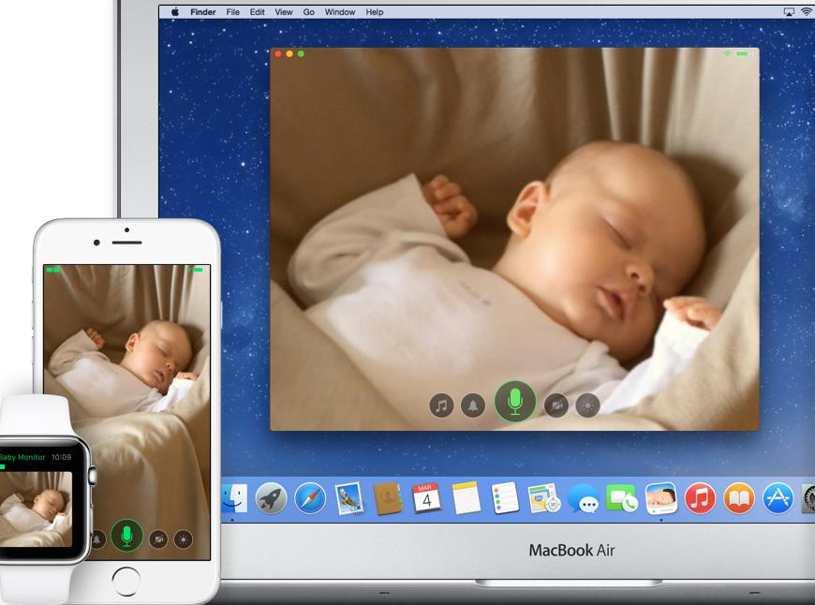

Problem Definition
In our day to day life,we are facing so many consequences ,particularly in
home security.Some of the following:
Robbery.
For Kids and Aged people.
For House Patient.
Relatives.

Slide 3


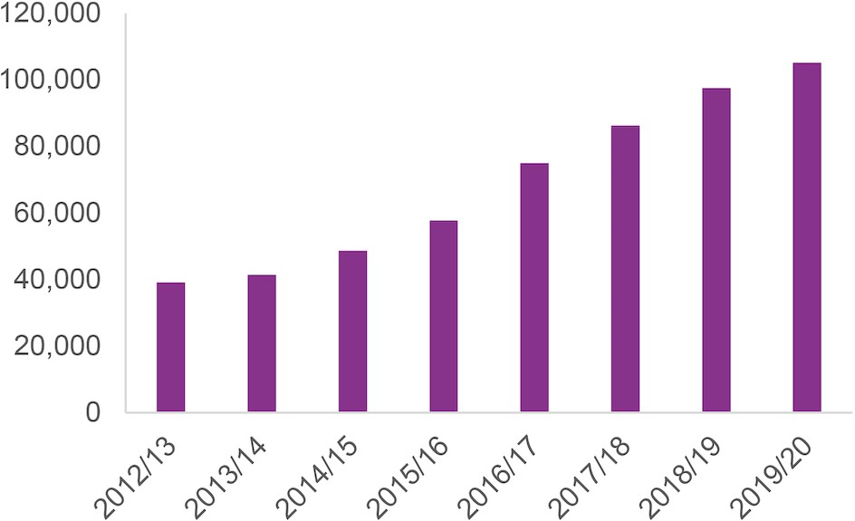
Market Analysis / Survey
ROBBERY STATISTICS
SOURCE:https://images.app.goo.gl/7 MZB55EBLvE8a9t48

Slide 4
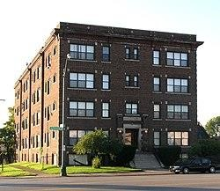



Target Customers
Apartments
Own houses
Smart city
In election voting

Slide 5
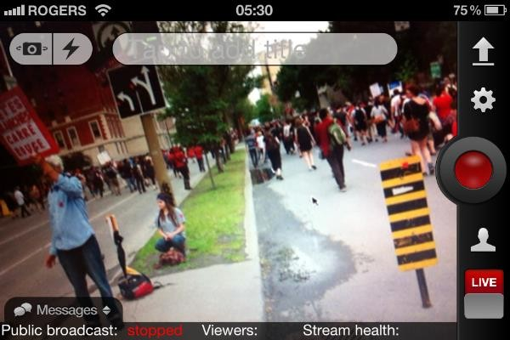
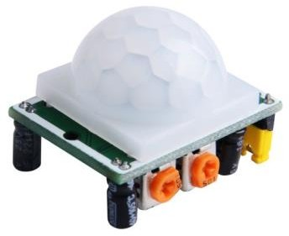
Solution
When the motion is detected the notification will come to the respective user then the user can watch a live stream via mobile application.

Slide 6
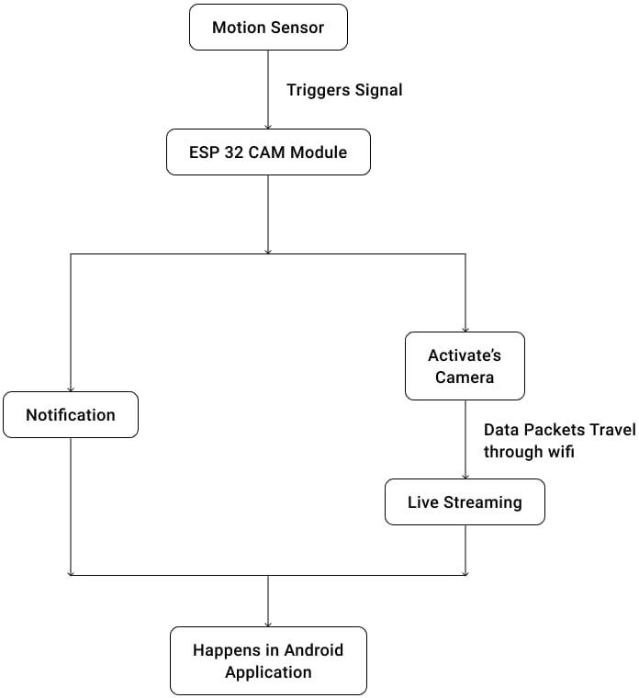
Block Diagram

Slide 7
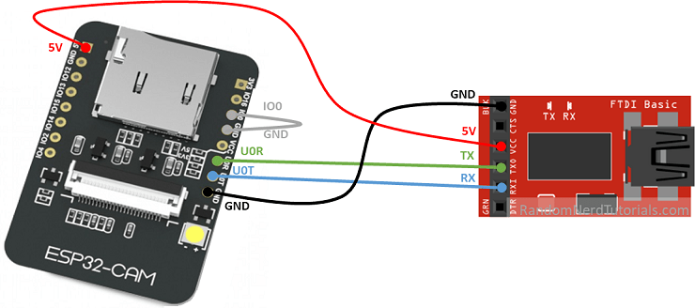

Circuit Diagram
FTDI MODULE
ESP 32CAM
PIR SENSOR

Slide 8
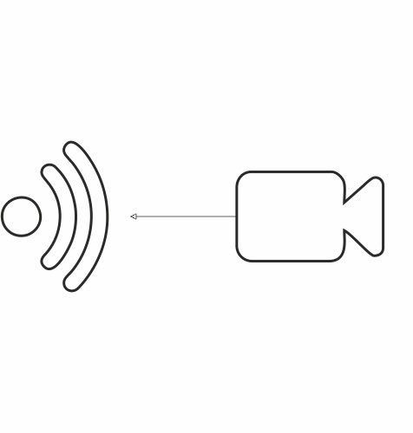


Core Innovation
Alerting notification
Face detection
Live Stream

Slide 9
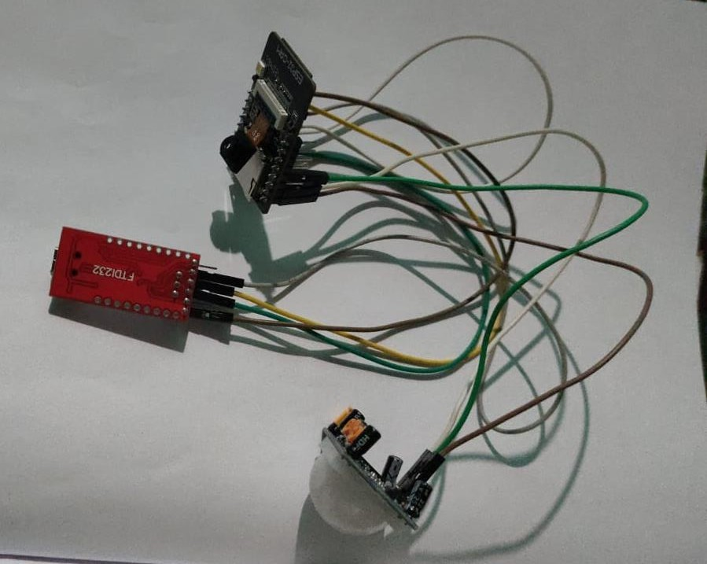
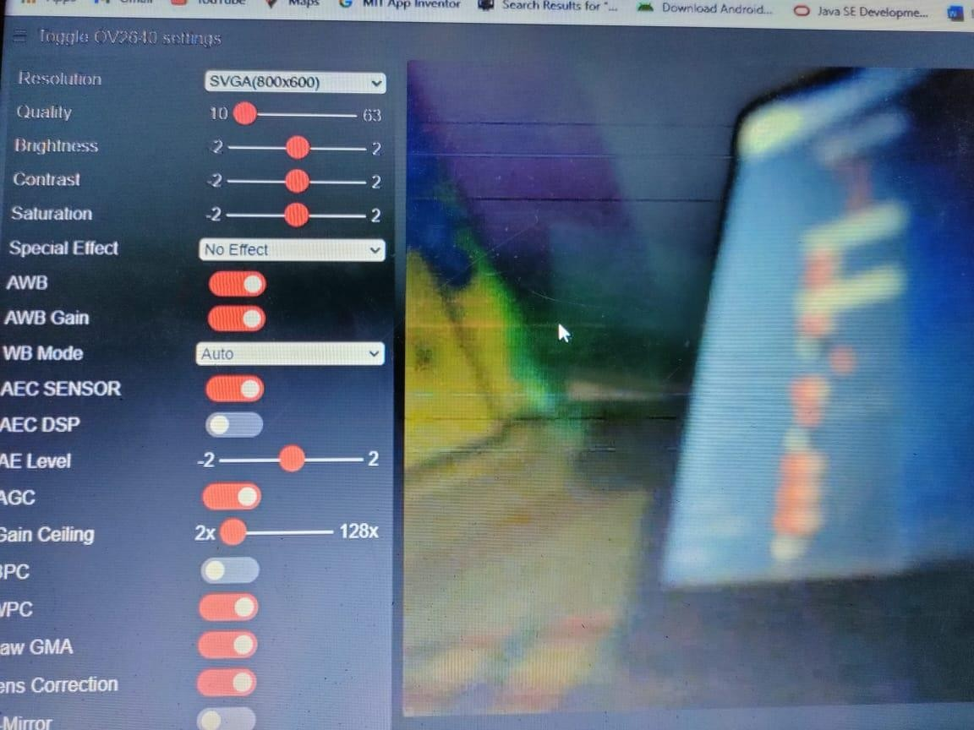
Prototype and Result

Slide 10

REFERENCES:
https://blog.asksensors.com/connect-pir-motion-sensor-esp32-mqtt/
https://randomnerdtutorials.com/installing-the-esp32-board-in-arduino-ide- windows-instructions/
https://electronicsinnovation.com/how-to-make-an-esp32-cam-blynk-app-
based-security-camera-with-motion-detection/
https://randomnerdtutorials.com/esp32-cam-pir-motion-detector-photo- capture/
https://www.electronics-lab.com/project/video-streaming-server-esp32-cam/
https://iotdesignpro.com/projects/iot-controlled-led-using-esp32-with-blynk-
app
https://www.viralsciencecreativity.com/post/esp32-cam-blynk-multiple-
camera-surveillance
https://www.elementzonline.com/blog/Accessing-ESP32-CAM-Video- Streaming-from-anywhere-in-the-world

Slide 11
http://192.168.82.131/
https://i0.wp.com/techtutorialsx.com/wp-content/uploads/2018/07/esp32- pir-motion-detector-arduino.png?resize=875%2C787&ssl=1
https://techtutorialsx.com/2018/07/01/esp32-arduino-pir-motion-sensor/
https://www.hackster.io/ashshaks/esp32-cam-face-detection-face-recognition-
2468e0
https://maker.pro/arduino/projects/how-to-build-an-esp32-based-facial- recognition-system
https://www.espressif.com/en/products/socs/esp32#:~:text=Engineered%20fo
r%20mobile%20devices%2C%20wearable,modes%20and%20dynamic%20pow
er%20scaling.
https://create.arduino.cc/projecthub/benjineering/easy-iot-remotely- controlling-esp32-using-an-android-app-99a1dd
https://www.instructables.com/How-to-Add-WiFi-Control-to-Any-Project-
ESP32-Begin/

Slide 12


